Slide 1
Unit Testing – Definition
A unit test is a piece of code, written by a developer that checks whether a piece of functionality (e.g. function or method), is working as expected.
Source code
Test code (unit tests)
function sortNums(arr) {
arr.sort(
(a,b) => a-b
);
}
let nums = [2, 15, -2, 4];
sortNums(nums);
if (JSON.stringify(nums)
!= "[-2,2,4,15]")
console.error("test failed!");

Slide 2



Unit Tests – Structure
The AAA Pattern: Arrange, Act, Assert
// Arrange all necessary preconditions and inputs
let nums = [2, 15, -2, 4];
// Act on the object or method under test
sortNums(nums);
// Assert that the obtained results are what we expect
if (JSON.stringify(nums) != "[-2,2,4,15]")
console.error("test failed!");

Slide 3


Unit Test – Sum Numbers – Example
function sum(arr) {
let sum = 0;
for (num of arr)
sum += Number(num);
return sum;
}
function testSum() {
if (sum([1, 2]) != 3) throw new Error("1+2 != 3");
if (sum([-2]) != -2) throw Error("-2 != -2");
if (sum([]) != 0) throw new Error("0 != 0");
}

Slide 4
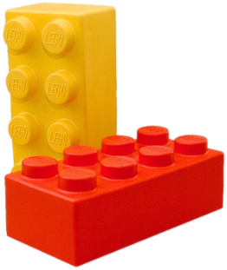

Unit Testing Framework
Unit testing frameworks make writing unit tests simple
Provides test cases, assertions, hooks, test runners, etc.
JUnit, NUnit, Visual Studio Team Test (VSTT), PHPUnit
JS unit testing: Mocha, QUnit, Unit.js, Jasmine, …
Assertion frameworks (perform checks)
Chai, Assert.js, Should.js
Mocking frameworks (mocks and stubs)
Sinon, JMock, Mockito, Moq

Slide 5
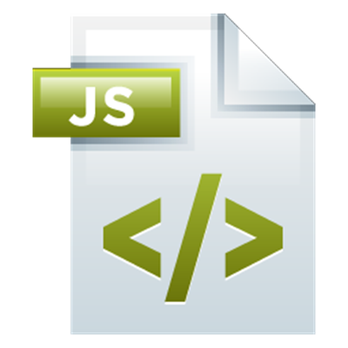



Mocha and Chai
Unit Testing in JavaScript

Slide 6
Mocha and Chai
Mocha is JS testing framework
Runs in Node.js and in Web browsers
Usually used together with Chai (assertion library)
let expect = require("chai").expect;
describe("sum(arr)", function() {
it("should return 3 for [1, 2]", function() {
expect(sum([1, 2])).to.be.equal(3);
});
});

Slide 7
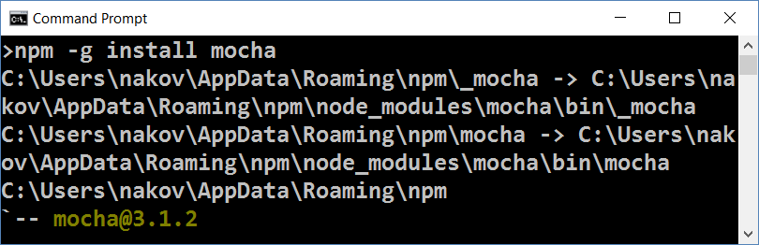
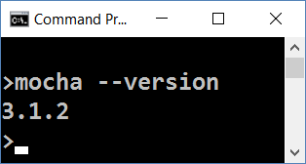
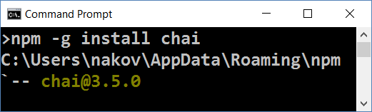
Installing Mocha and Chai
Install Mocha through npm
Check if Mocha is installed
npm -g install mocha
mocha --version
Install Chai through npm
npm -g install chai

Slide 8
Configuring NODE_PATH
By default Node.js does not find its globally-installed modules
You need to set the NODE_PATH environment variable
You may need to restart your IDE after changing NODE_PATH
rem for any future sessions
setx NODE_PATH %AppData%\npm\node_modules
rem for current session
set NODE_PATH=%AppData%\npm\node_modules

Slide 9
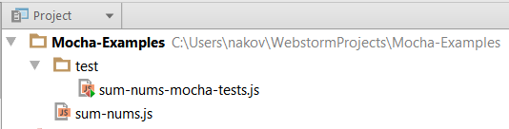
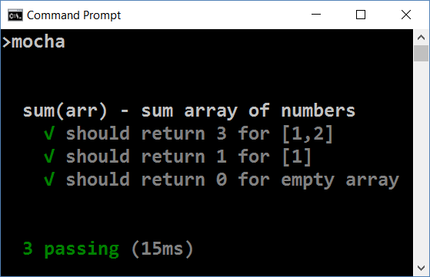
Running Mocha
Create folder "test" in your JS project
Put your test code in test/{test-group-name}.js
Run Mocha from the console
mocha

Slide 10
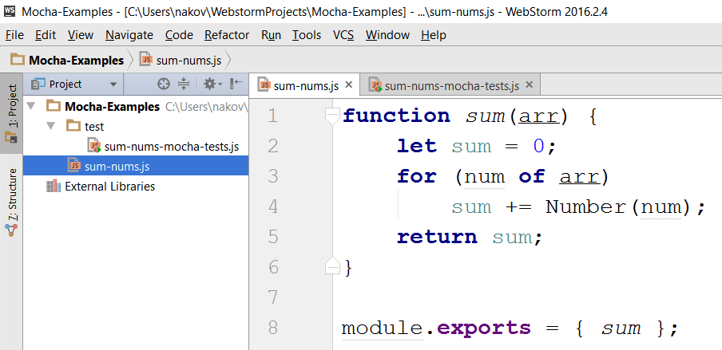
Mocha in Action – Sample Project
Source code to be tested

Slide 11
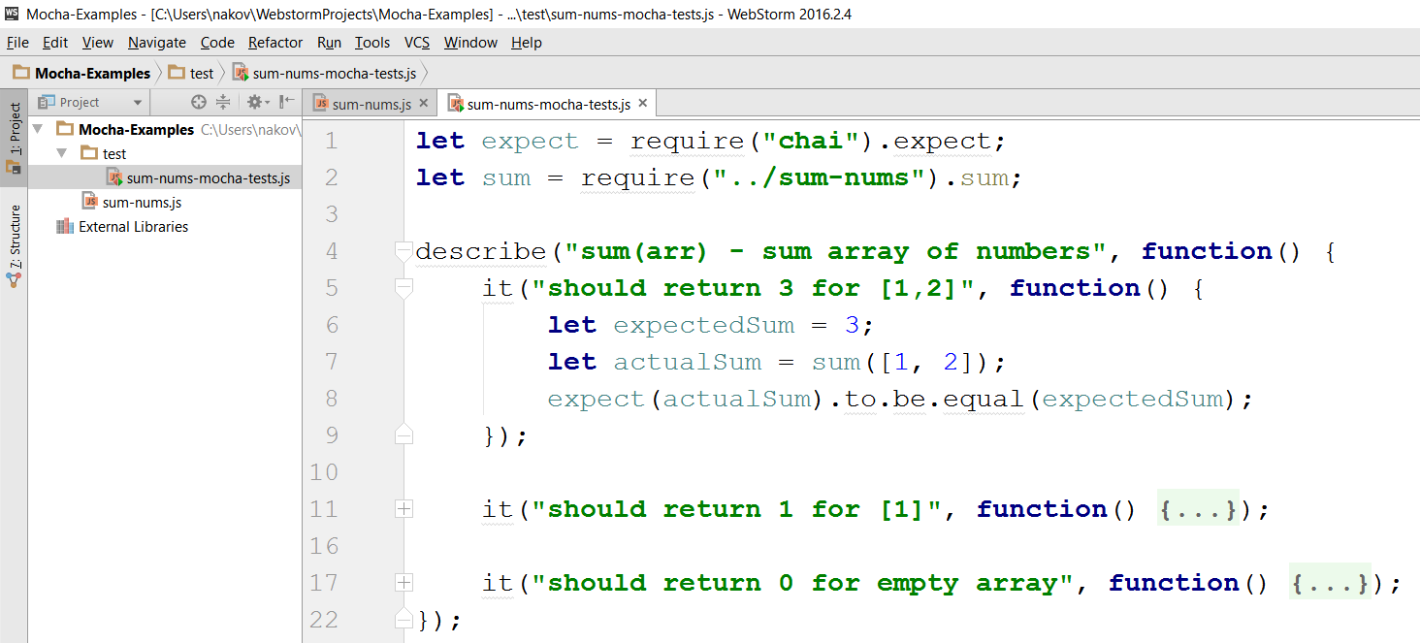
Mocha in Action – Sample Unit Tests
Tests for the sum(arr) function

Slide 12
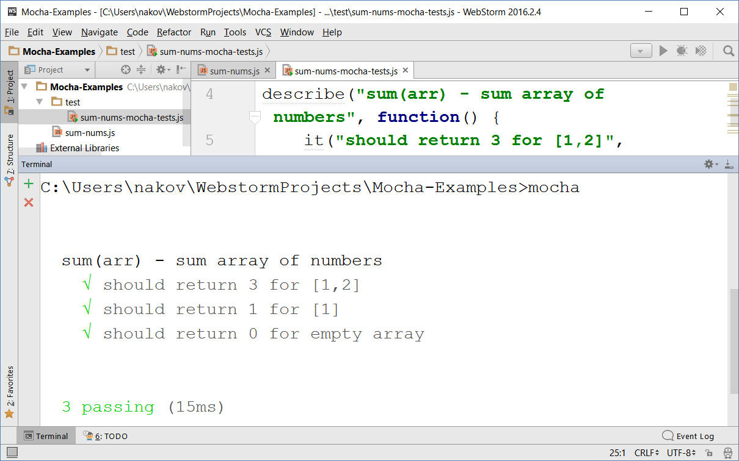
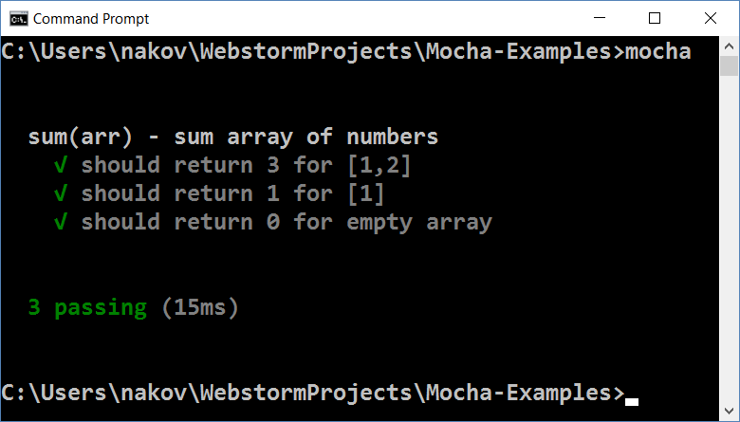
Mocha in Action – Running the Tests

Slide 13
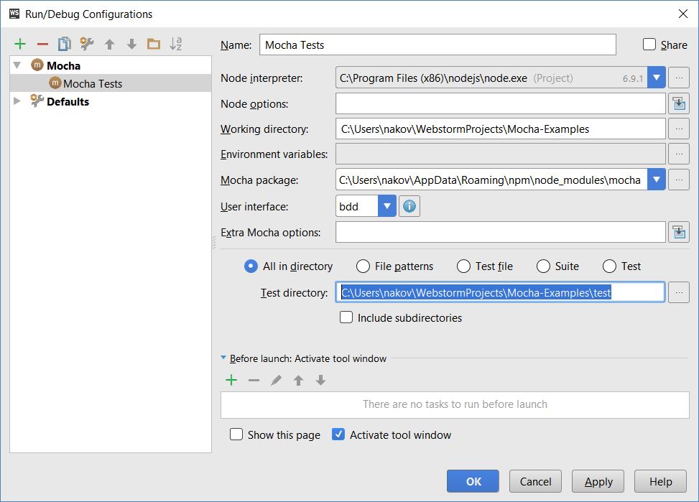
Running Mocha Tests from WebStorm

Slide 14

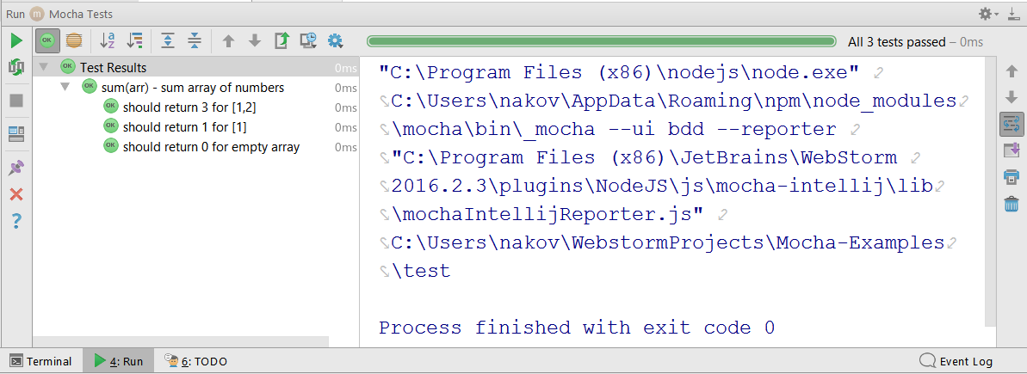
Running Mocha Tests from WebStorm (2)

Slide 15
Test Groups and Test Cases
describe("Test group #1", function() {
it("should … when …", function() {
expect(actual).to.be.equal(expected);
});
it("should … when …", function() { … });
});
describe("Test group #2", function() {
it("should … when …", function() {
expect(actual).to.be.equal(expected);
});
…
});

Slide 16
Problem – Sum of Numbers
You are given a JS code intended to sum an array of numbers:
Write unit tests to test the sum(arr) function with Mocha
function sum(arr) {
let sum = 0;
for (num of arr)
sum += Number(num);
return sum;
}
Check your solution here: https://judge.softuni.bg/Contests/307

Slide 17

Solution – Sum of Numbers – Test Cases
Design the test cases
sum([1, 2]) → 3
sum([1]) → 1
sum([]) → 0
sum([1.5, 2.5, -1]) → 3
sum("invalid data") → NaN

Slide 18

Solution – Sum of Numbers – Test Code
describe("sum(arr) - sum array of numbers", function() {
it("should return 3 for [1, 2]", function() {
expect(sum([1, 2])).to.be.equal(3);
});
it("should return 1 for [1]", function() {
expect(sum([1])).to.be.equal(1);
});
it("should return 0 for empty array", function() { … });
it("should return 3 for [1.5, 2.5, -1]", function() { … });
it("should return NaN for invalid data", function() { … });
});
Check your solution here: https://judge.softuni.bg/Contests/307

Slide 19
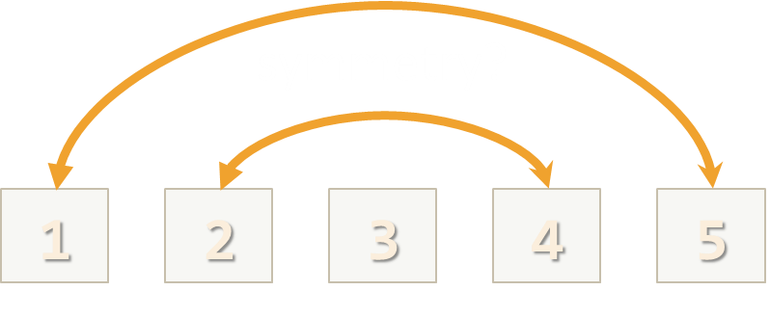
Problem – Check for Symmetry
You are given the following JS code:
Write unit tests to test the above function with Mocha
function isSymmetric(arr) {
if (!Array.isArray(arr))
return false; // Non-arrays are non-symmetric
let reversed = arr.slice(0).reverse(); // Clone + reverse
let equal =
(JSON.stringify(arr) == JSON.stringify(reversed));
return equal;
}
Check your solution here: https://judge.softuni.bg/Contests/307

Slide 20
Solution – Check for Symmetry – Test Cases
Design the test cases
[1,2,3,3,2,1] → true [1,2,3,4,2,1] → false
[-1,2,-1] → true [-1,2,1] → false
[1,2] → false [1] → true
[5,'hi',{a:5},new Date(),{a:5},'hi',5] → true
[5,'hi',{a:5},new Date(),{X:5},'hi',5] → false
1,2,2,1 → false (not an array)

Slide 21
Solution – Check for Symmetry – Test Code
describe("isSymmetric(arr) ", function() {
it("should return true for [1,2,3,3,2,1]", function() {
let symmetric = isSymmetric([1,2,3,3,2,1]);
expect(symmetric).to.be.equal(true);
});
it("should return false for [1,2,3,4,2,1]", function() { … });
it("should return true for [-1,2,-1]", function() { … });
it("should return false for [-1,2,1]", function() { … });
…
});
Check your solution here: https://judge.softuni.bg/Contests/307

Slide 22
Problem – RGB to Hex Color
Using Mocha write unit tests for the following function:
function rgbToHexColor(red, green, blue) {
if (!Number.isInteger(red) || (red < 0) || (red > 255))
return undefined; // Red value is invalid
if (!Number.isInteger(green) || (green < 0) || (green > 255))
return undefined; // Green value is invalid
if (!Number.isInteger(blue) || (blue < 0) || (blue > 255))
return undefined; // Blue value is invalid
return "#" +
("0" + red.toString(16).toUpperCase()).slice(-2) +
("0" + green.toString(16).toUpperCase()).slice(-2) +
("0" + blue.toString(16).toUpperCase()).slice(-2);
}

Slide 23
Solution – RGB to Hex Color – Test Cases
Design the test cases
Start from the typical (normal) cases
(255, 158, 170) → #FF9EAA
(12, 13, 14) → #0C0D0E
(0, 0, 0) → #000000
(255, 255, 255) → #FFFFFF
Then, test the special cases, e.g. invalid input
(-1, 0, 0), (0, -1, 0), (0, -1, 0) → undefined
(256, 0, 0), (0, 256, 0), (0, 0, 256) → undefined
(3.14, 0, 0), (0, 3.14, 0), (0, 0, 3.14) → undefined
("5", [3], {8:9}), (empty input) → undefined

Slide 24
Solution – RGB to Hex Color – Test Code
describe("rgbToHexColor(red, green, blue)", function() {
describe("Nominal cases (valid input)", function() {
it("should return #FF9EAA on (255, 158, 170)", function() {
let hex = rgbToHexColor(255, 158, 170);
expect(hex).to.be.equal('#FF9EAA');
});
…
});
describe("Special cases (invalid input)", function() {
…
});
});
Check your solution here: https://judge.softuni.bg/Contests/307

Slide 25
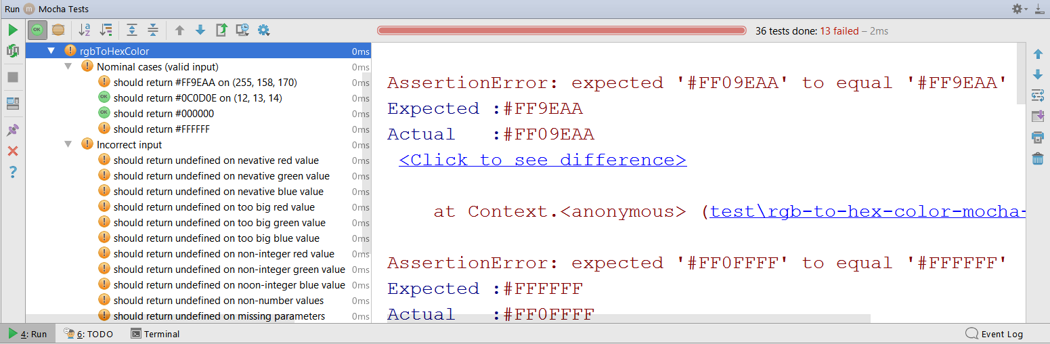
Testing Incorrect Code
function rgbToHexColor(red, green, blue) {
return "#" +
("0" + red.toString(16).toUpperCase()).slice(-2) +
("0" + green.toString(16).toUpperCase().slice(-2)) +
("0" + blue.toString(16).toUpperCase()).slice(-2);
}

Slide 26
Problem – Add / Subtract Module
You are given the following JS code:
Write unit tests to test the above code with Mocha
function createCalculator() {
let value = 0;
return {
add: function(num) { value += Number(num); },
subtract: function(num) { value -= Number(num); },
get: function() { return value; }
}
}
Check your solution here: https://judge.softuni.bg/Contests/307

Slide 27
Solution – Add / Subtract – Test Cases
Design the test cases
create; get → 0
create; add(2); add(3); get → 5
create; subtract(3); subtract(2); get → -5
create; add(5.3); subtract(1.1); get → 4.2
create; add(10); subtract('7'); add('-2'); subtract(-1); get → 2
create; add('hello'); get → NaN
create; subtract('hello'); get → NaN

Slide 28
Solution – Add / Subtract – Test Code
describe("createCalculator()", function() {
let calc;
beforeEach(function() {
calc = createCalculator();
});
it("should return 5 after {add 3; add 2}", function() {
calc.add(3); calc.add(2); let value = calc.get();
expect(value).to.be.equal(5);
});
…
});
Mocha hook: called before each test
Check your solution here: https://judge.softuni.bg/Contests/307

Slide 29

Practice: Unit Testing in JS
Live Exercises in Class (Lab)

Slide 30


Summary
Unit tests are programs that check whether a piece of code works as expected
Mocha + Chai are tools for JS unit testing
npm -g install mocha chai
let expect = require("chai").expect;
describe("sum(arr)", function() {
it("shoud sum 1+2 = 3", function() {
expect(sum([1, 2])).to.be.equal(3);
});
});
mocha

Slide 31









Unit Testing with Mocha
https://softuni.bg/courses/javascript-advanced

Slide 32

License
This course (slides, examples, demos, videos, homework, etc.) is licensed under the "Creative Commons Attribution-NonCommercial-ShareAlike 4.0 International" license

Slide 33






Free Trainings @ Software University
Software University Foundation – softuni.org
Software University – High-Quality Education, Profession and Job for Software Developers
softuni.bg
Software University @ Facebook
facebook.com/SoftwareUniversity
Software University @ YouTube
youtube.com/SoftwareUniversity
Software University Forums – forum.softuni.bg

